Slide 1
Marine Mammals in Burrows Pass and the Salish Sea
Biota Maxima
2018
Please acknowledge Biota Maxima if you use this material.

Slide 2
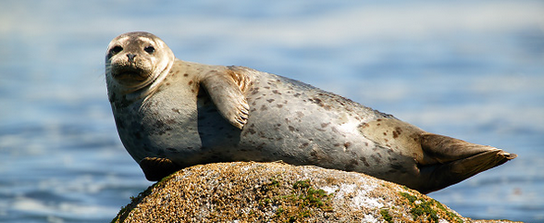
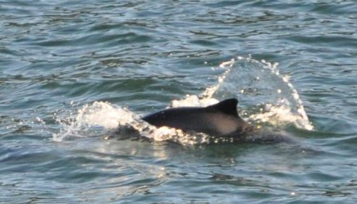
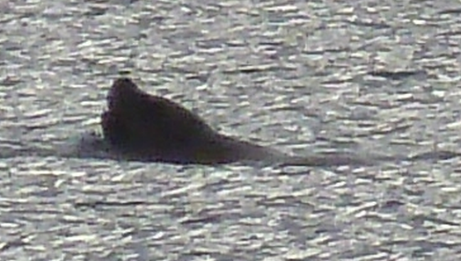
Marine Mammals in Burrows Pass and the Salish Sea
www.wildnatureimages.com
Photo: Steven Gnam
Photo: Connie Walser

Slide 3

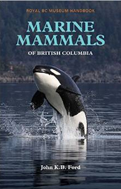
References for Marine Mammals
A Guide to Marine Mammals of Greater Puget Sound Paperback – May, 1988 by Richard Osborne (Author), John Calambokidis
Marine Mammals of British Columbia Paperback – September 15, 2014
by John KB Ford
NOAA Stock Assessments

Slide 4
The following are the most commonly seen
Harbor Porpoise
Harbor Seal
River Otter
Other species seen in Burrows Pass – rarely
  Hybrid – Harbor/Dall’s
  California Sea Lion
  Humpback Whale and Calf
Anything might show up – be prepared!

Slide 5
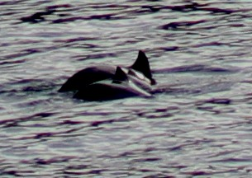
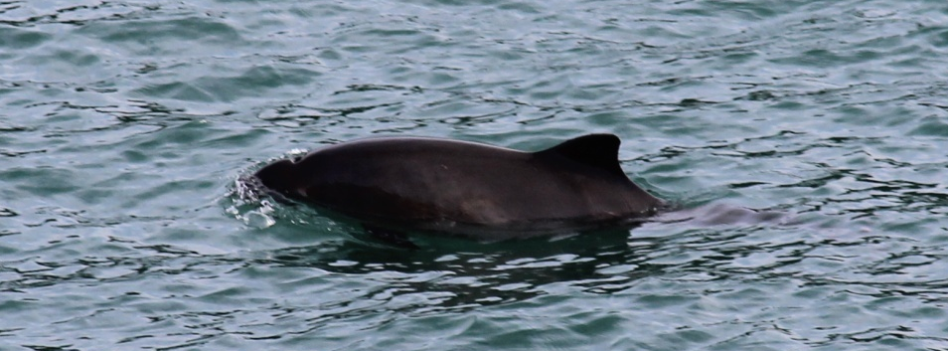
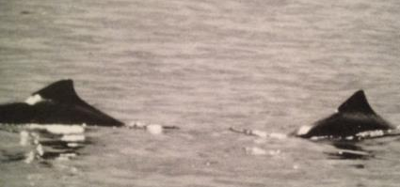
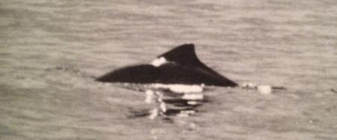
Harbor Porpoise
Social Behavior
Small: 5ft, 150lbs
Single or groups of 2 to 3
Large groups are observed occasionally
Usually do not come far out of water
A guide to marine mammals of greater Puget Sound

Slide 6
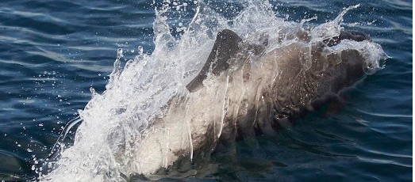
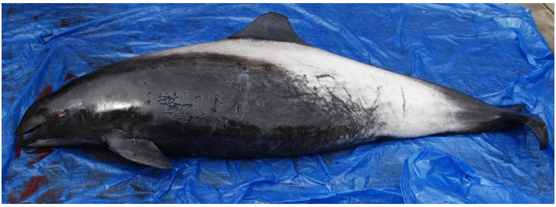
Harbor Porpoise and Dall’s Porpoise can Hybridize
Hybrids identified have been male harbor and female Dall’s. Their offspring are fertile. Many are seen in Puget Sound. Watch for large patches of white on body
And Hybrids do bow ride -
Credit Andrew Lee
These might be seen in the pass
Stranding Network

Slide 7
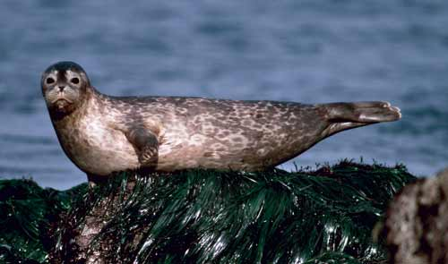
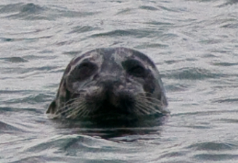
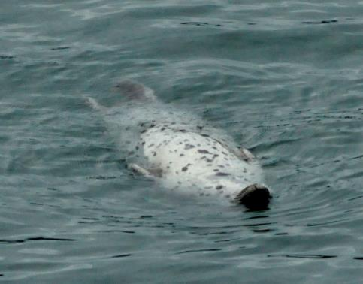
Harbor Seal
5-6 ft; up to 300lbs
Gray to brown, white belly, spots
No outer ear flaps
Rounded head usually what is seen
Float at surface for extended periods of time
www.seagrant.uaf.edu
This one likes to float on his back
Photo: Bryan Hanson
Who is watching who?

Slide 8
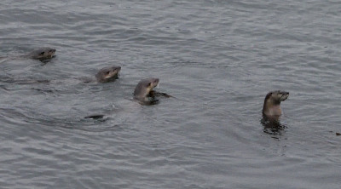
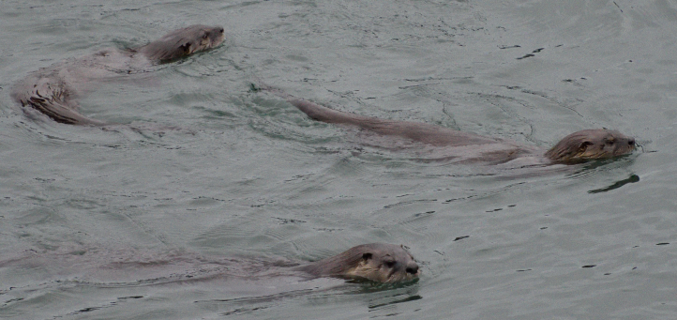
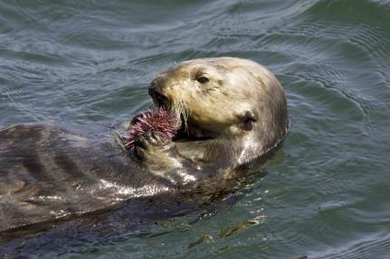
River Otter
4ft; 20-28lbs
Tail long and pointed
Swims belly down
May come out on land
Sea Otter twice as large
Floats on back
Stays in water
SEA OTTER
www.news.nationalgeographic.org
Burrows Pass River Otters

Slide 9
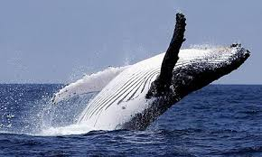
Cetaceans
Baleen Whales
  Gray
  Minke
  Humpback
Dolphin
  Pacific White-sided
  Resident Orca
  Transient Orca
  Rissos - rare
Photo: theguardian.com
Porpoises
  Harbor
  Dall’s

Slide 10
Pinnipeds and Mustelids
Pinnipeds
Harbor Seal - common
California Seal Lion- occasional
Stellar Sea Lion – less common
Mustelidae – weasels
River Otter - common
Sea Otter – just returning – seen at San Juan Island

Slide 11
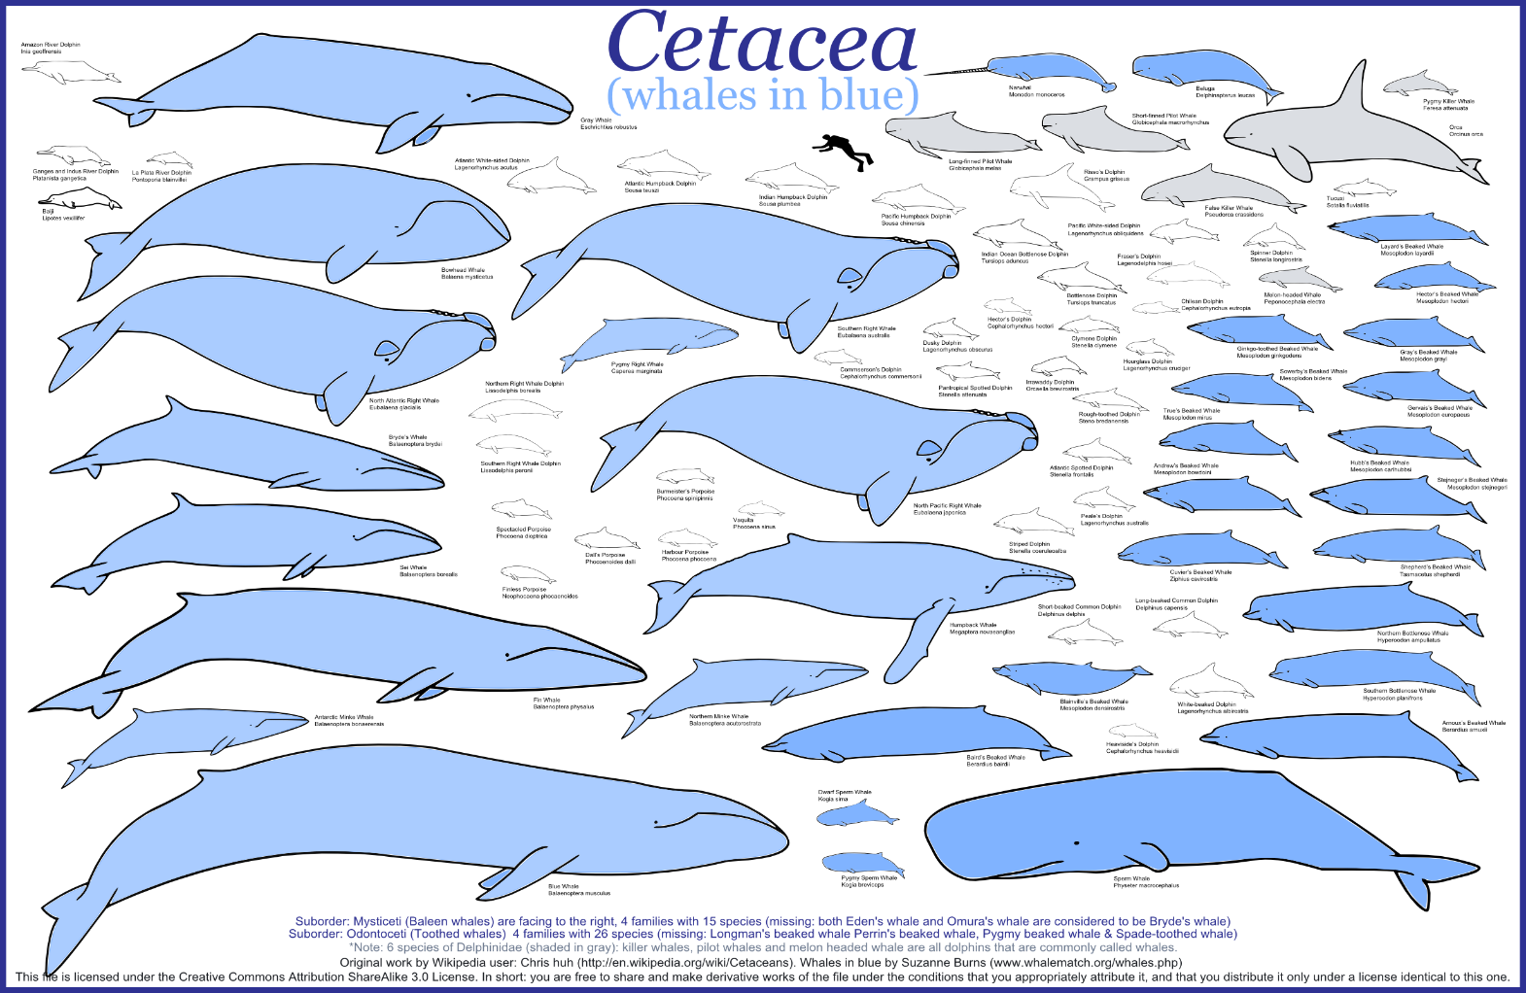
American Cetacean Society - Size Comparison
Orca
Minke
Humpback
Gray Whale

Slide 12
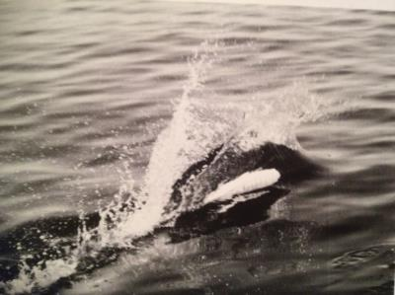
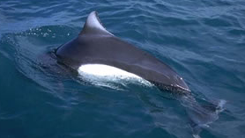
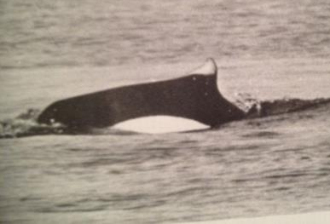
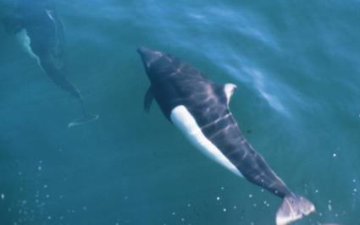
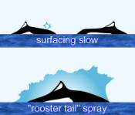
Dall’s porpoise – same size as harbor porpoise
Most important to note if it is seen in Burrows Pass – none seen to date
Black and white (similar to Orca)
Average 6 feet, 270 pounds
Group size 10-20
Characteristic rooster tail splash/spray
Rooster tail splash
www.whale-watching-alaska.com
www.whales.org.au
A guide to marine mammals of greater Puget Sound
www.acsonline.org

Slide 13


Porpoises
Porpoises have spade shaped teeth
Dolphin have small conical teeth
Harbor
Dall’s
Weight: | 60 kg
Length: | 1.7 meters
Appearance: | dark gray with white underside
Lifespan: | about 24 years
Diet: | herring, capelin, and cephalopods
Behavior: | non-social animals usually seen in groups of 2 to 5 animals;
Weight: | 200 kg
Length: | 2.3 meters
Appearance: | Black with white areas
Lifespan: | about 15-20 years
Diet: | anchovies, herring, hake, smelts, squid, octopus, and occasionally crabs and shrimp
Behavior: | usually found in groups averaging between 2-20 individuals
http://www.nmfs.noaa.gov/pr/species/mammals/cetaceans/htm

Slide 14
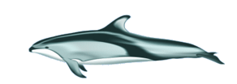
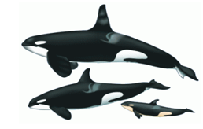
Dolphin
Pacific White-sided Dolphin
Appearance: Robust body, short beak
Weight: 150 kg
Length: 2 meters
Life span: 40 years
Diet: squid, capelin, sardines, and herring
Behavior: active, bow ride, 20 to 100, up to 1000
Orca - Resident and Transient
Appearance: Black with white patterns
Weight: 11 tons
Length: 10 m
Life span: 50-60 up to 100 years
Behavior: highly social animals, matriarchal societies

Slide 15
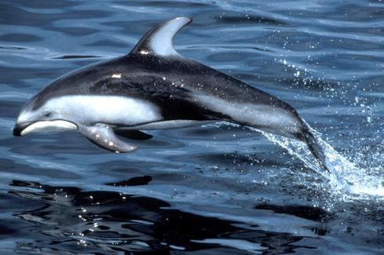
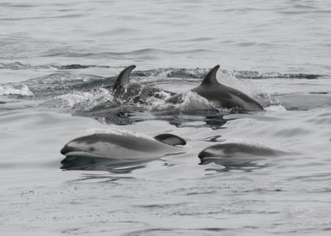
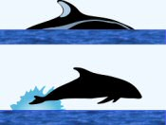
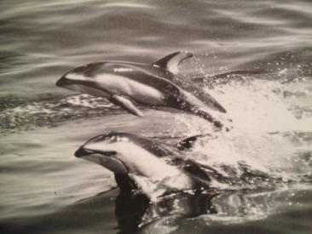
Pacific White-sided Dolphin
7-8 ft, 300 pounds
VERY energetic, playful
Larger groups, 90-100 common
www.ask.com
www.acsonline.org
www.bcadayatatime.com
These might show up in Burrows Pass
A guide to marine mammals of greater Puget Sound

Slide 16
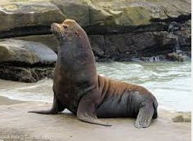
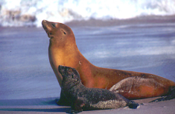
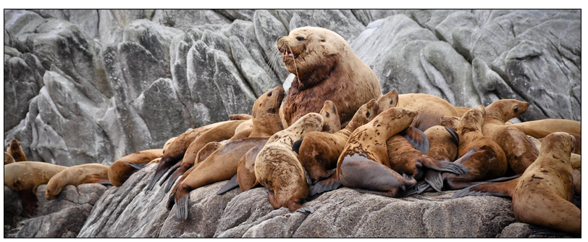
California Sea Lion
Mostly in California - population increasing - may be moving north. Outside of the breeding season, males migrate to the northern ends of the species range to feed, while females forage near the breeding rookeries. Males develop a sagittal crest with pronounced forehead. May have patch of tan hair on crest with rest of pelt dark
NOAA.gov
Sanctuarysimon.com
Photo: Marine Mammal Consortium - UBC

Slide 17
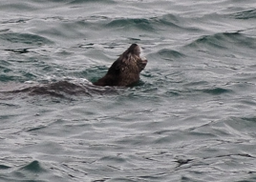
California Sea Lion - as an observer, this is what you will likely see – a silhouette above water
Photo: Steven Gnam
Photo: Connie Walser

Slide 18
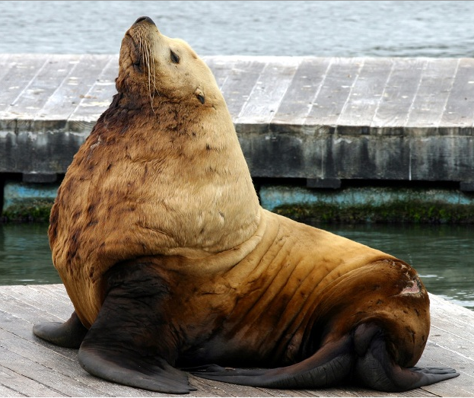
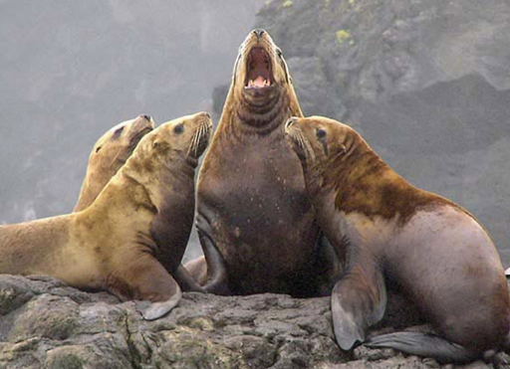
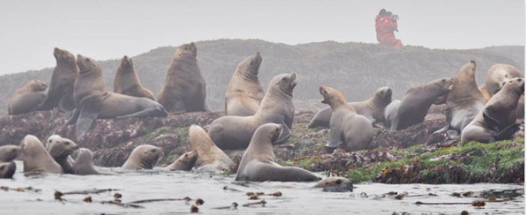
Stellar Sea Lion-
Much less common
http://www.marinemammalcenter.org/education/marine-mammal-information/pinnipeds/steller-sea-lion/
Males develop thick neck and mane. Northern population declining – may be due to food supply

Slide 19
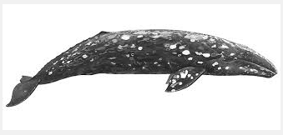
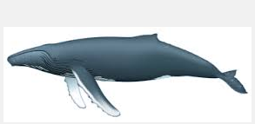
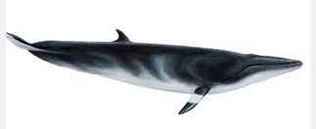
Baleen Whales
Gray Whale
Humpback
Minke
Marine Mammal Center.org
Photos ACS Online
GentleGiants.is

Slide 20
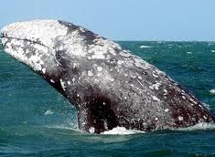
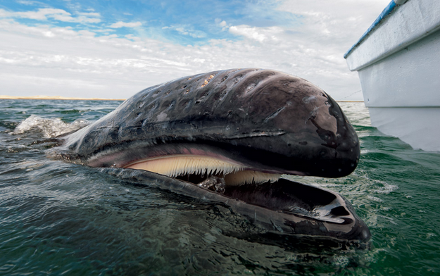
Gray Whale
Weight: | 40 tons
Length: | 15 meters long
Appearance: | mottled gray body, with small eyes; they have a "dorsal hump" (not a dorsal fin) and a series of 8-14 small bumps, known as "knuckles"
Lifespan: | unknown, but may be as long as 80 years; sexually mature at around 8 years old
Diet: | bottom feeders, they eat "benthic" amphipods up to 2000 pounds per day
Behavior: | traveling alone or in small, unstable groups
Cascadia Research Collective and others are identifying and cataloging the whales that stay in the area
Credits: left - Christopher Swann from http://ngm.nationalgeographic.com/2011/11/visions-now-next, 2014; right - Alejandro Zepeda/EPA

Slide 21
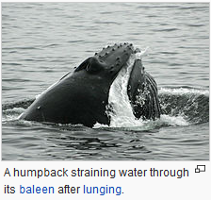
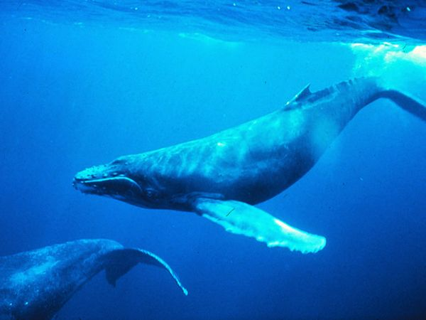
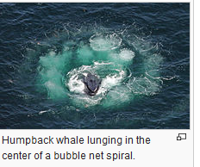
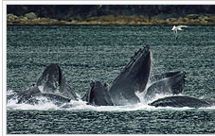
Humpback feed on krill and small fishes
Weight: | 33 tons
Length: | 18 meters with females larger than males;
Appearance: | primarily dark grey, with some areas of white
Lifespan: | about 50 years
Diet: | tiny crustaceans (mostly krill), plankton, and small fish
Behavior: | breaching (jumping out of the water), or slapping the surface
http://www.nmfs.noaa.gov/pr/species/mammals/cetaceans/
NOAA StatusReport

Slide 22
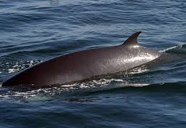
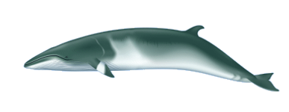
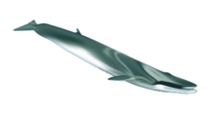

Minke
Weight: | 10 tons
Length: | 10 meters
Appearance: | small, dark (black/gray), sleek body with white underside
Lifespan: | up to 50 years; sexually mature at around 3-8 years of age
Diet: | krill, plankton, anchovies, herring, salmon, sand lance
Behavior: | often active at the surface, they are commonly seen "breaching" and "spy hopping"; they create sounds including "clicks" and "boings"
http://www.nmfs.noaa.gov/pr/species/mammals/cetaceans/
Fin Whale
Whale Museum identified many of these whales from dorsal fin photographs.
Sei Whale

